Slide 1
Css and sass
What I’ve learnt from the trillo project
https://github.com/ruthlaird/advanced-css-course/tree/master/Trillo

Slide 2
flexbox
Used to align elements to one another, in different directions and orders
Gives the container the ability to expand and shrink elements to best use the available space
Replaces float layouts, using less, more readable and more logical code
Used for ONE dimensional layouts
N.B. Not fully supported in IE11 ☹

Slide 3
Flexbox (with default direction of row)
Flex container
Flex items
MAIN AXIS
CROSS AXIS

Slide 4
Flexbox (with FLEX-direction: column)
Flex container
Flex items
CROSS AXIS
MAIN AXIS

Slide 5
Flexbox properties – container properties
flex-direction: row | row-reverse | column | column-reverse specifies in which direction the main axis goes
flex-wrap: nowrap | wrap | wrap-reverse defines if the flex items should wrap into a new line if there’s not enough space in the flex container
justify-content: flex-start | flex-end | center | space-between | space-around | space-evenly defines how the flex items will be aligned along the MAIN axis
align-items: stretch | flex-start | flex-end | center | baseline defines how the flex items will be aligned along the CROSS axis
align-content: stretch | flex-start | flex-end | center | space-around | space-between only applies when there is more than one row (or if flex-direction=column, columns) of flex items; controls how the rows/columns are aligned along the CROSS axis
space is evenly distributed between flex items
space on both left and right of items
aligns the text of all items vertically

Slide 6
Flexbox properties – item properties
align-self: auto | stretch | flex-start | flex-end | center | baseline similar to align-items but for one individual flex item
order: 0 | <integer> defines the order in which one specific flex item should appear inside the container => helpful to re-order items e.g. for smaller screens
flex-grow: 0 | <integer> defines how much an item can grow
flex-shrink: 1 | <integer> defines how much an item can shrink (0 = can’t shrink)
flex-basis: auto | <length> defines an item’s base width
shortened to flex e.g. flex: 0 1 auto

Slide 7
Example code for playing with in codepen - html
<div class="container">
<div class="item">1</div>
<div class="item i2">2</div>
<div class="item i3">3</div>
<div class="item i4">4</div>
<div class="item">5</div>
<!-- <div class="item">6</div>
<div class="item">7</div>
<div class="item">8</div>
<div class="item">9</div>
<div class="item">10</div> -->
</div>

Slide 8
Example code for playing with in codepen - css
* {
margin: 0;
padding: 0;
box-sizing: border-box;
}
.container {
background-color: #ccc;
padding: 10px;
height: 1000px;

Slide 9
Example code for playing with in codepen - css
display: flex;
/* flex-direction: row-reverse; */
/* flex-direction: column; */
/* flex-direction: column-reverse; */
/* justify-content: flex-end; */
/* justify-content: center; */
/* justify-content: space-between; */
/* justify-content: space-around; */
/* justify-content: space-evenly; */
/* align-items: flex-start; */
/* align-items: flex-end; */
/* align-items: center; */
/* align-items: baseline; */
/* flex-wrap: wrap; */
/* flex-wrap: wrap-reverse; */
/* align-content: flex-start; */
/* align-content: flex-end; */
/* align-content: center; */
/* align-content: space-around; */
/* align-content: space-between; */
}

Slide 10
Example code for playing with in codepen - css
.item {
background-color: #f1425d;
padding: 30px;
margin: 30px;
color: #fff;
font-size: 40px;
/* flex-grow: 1; */
/* flex: 1; */
}

Slide 11
Example code for playing with in codepen - css
.i2 {
height: 200px;
/* order: 2; */
/* flex: 2; */
/* flex: 3; */
/* flex-basis: 20%; */
/* flex-basis: 300px; */
/* flex-shrink: 1; */
/* flex-shrink: 0; */
flex: 0 0 300px;
}

Slide 12
Example code for playing with in codepen - css
.i3 {
/* order: -2; */
/* order: 1; */
/* flex: 1; */
}
.i4 {
font-size: 70px;
/* align-self: stretch; */
/* align-self: flex-start; */
/* align-self: flex-end; */
/* align-self: center; */
/* align-self: baseline; */
/* order: -1; */
}

Slide 13
Trillo application - header
.user-nav { display: flex;
align-items: center;
align-self: stretch;
}
.search { flex: 0 0 40%;
display: flex; //flex item is becoming a flex container for it’s children
align-items: center;
justify-content: center;
}
.header {
font-size: 1.4rem;
height: 7rem;
background-color: var(--color-white);
border-bottom: var(--line);
display: flex;
justify-content: space-between;
align-items: center; }

Slide 14


Trillo application – side bar
.sidebar {
background-color: var(--color-grey-dark-1);
flex: 0 0 18%; //don't grow or shrink and width is 18%
display: flex;
flex-direction: column;
justify-content: space-between; //This has the effect of pushing the legal text to the bottom
}

Slide 15
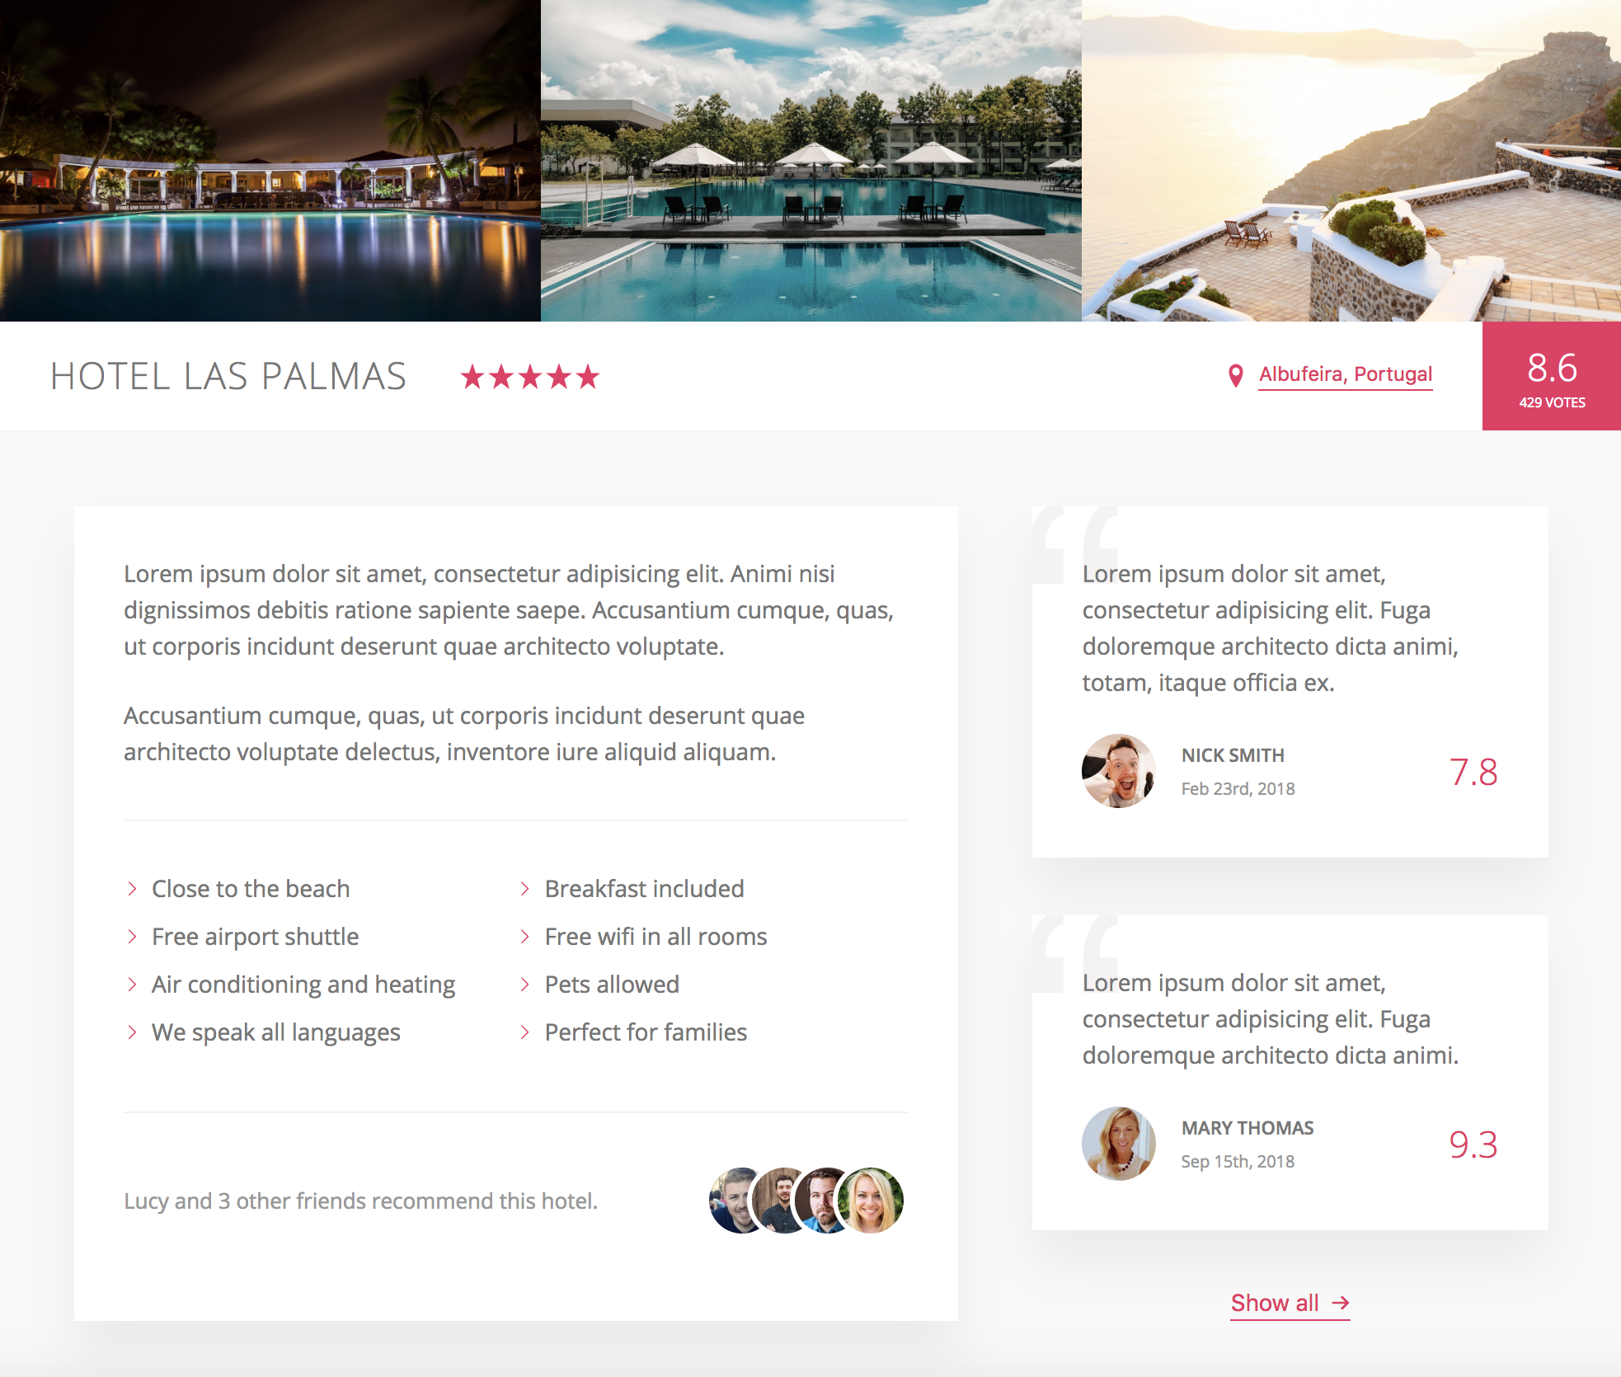
Trillo application – hotel view
.gallery {
display: flex;
&__photo {
width: 100%;
//for responsive images should always set width & height in percentages
display: block;
//stops it having a space underneath the image which it would get if
it was an inline element
}
}
.hotel-view {
background-color: var(--color-white);
flex: 1; //grow as much as it can
}
.overview {
display: flex;
align-items: center;
&__location {
display: flex;
align-items: center;
}
&__rating {
align-self: stretch;
display: flex;
flex-direction: column;
align-items: center;
justify-content: center;
}
}
.description {
flex: 0 0 60%; //takes up 60% of the width
}
.user-reviews {
flex: 1;
//grows to occupy the
remaining space
display: flex;
flex-direction: column;
align-items: center;
}

Slide 16
Custom properties / css variables
Use variables in CSS rather than in SCSS
Can manipulate in JavaScript and edit them in dev tools
CSS variables cascade and are inherited
Have to be defined in a declaration block (best to put in root pseudo class – like html selector but higher specificity):
:root {
--color-primary: #eb2f64;
}
color: var(--color-primary);
specify variable with ‘--’ prefix
call using ‘var()’

Slide 17


currentcolor
.btn-inline {
border: none;
color: var(--color-primary);
border-bottom: 1px solid currentColor;
//border gets the same colour as the text, then when add hover it changes automatically
&:hover {
color: var(--color-grey-dark-1); }

Slide 18
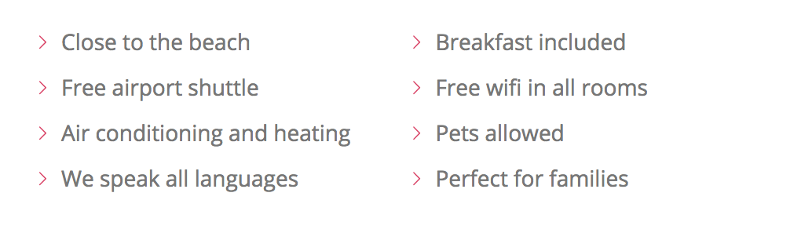
mask
.list {
&__item::before {
content: ""; //have to specify a content property to get image to appear
display: inline-block;
height: 1rem;
width: 1rem;
margin-right: .7rem;
//for older browsers as mask only supported by newer ones - can't change the color of the image when using background-image
background-image: url(../img/chevron-thin- right.svg);
background-size: cover;
//newer browsers - mask (background color only shows through the mask (in this case the chevron image)
@supports (-webkit-mask-image: url()) or (mask-image: url()) {
background-color: var(--color-primary);
-webkit-mask-image: url(../img/chevron-thin- right.svg);
-webkit-mask-size: cover;
mask-image: url(../img/chevron-thin-right.svg);
mask-size: cover;
background-image: none; //have to remove background image to stop it appearing instead of the mask
}

